Slide 1
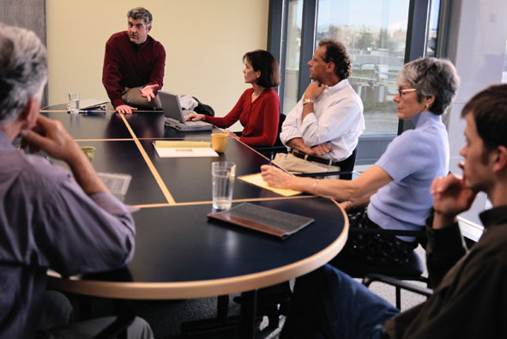
Effective Meetings
How to for Supervisors
Notes:
Slide Show Notes
Today we’re going to talk about planning and conducting effective meetings. We’ll also briefly discuss how you can participate in other people’s meetings more effectively.
This session is important because too many meetings turn out to be time-consuming distractions from your other important work. Poorly planned and conducted meetings often serve little purpose and waste valuable resources. Just consider the cost of a meeting involving 10 people that runs for half an hour. That adds up to 5 hours worth of salaries and time taken away from other productive work.
Yet meetings can also be an excellent way to handle many important aspects of your business. Knowing how to plan and lead focused, efficient meetings is, therefore, an important supervisory skill.

Slide 2
Session Objectives
You will be able to:
  Plan meetings to achieve the best results
  Conduct meetings efficiently
  Participate more effectively in other
  people’s meetings
Notes:
Slide Show Notes
The main objective of this session is to help you use meetings effectively to accomplish important goals. By the time this session is over, you should be able to:
Plan meetings to achieve the best results;
Conduct meetings efficiently; and
Participate more effectively in other people’s meetings.

Slide 3



Why Have a Meeting?
  Exchange information
  Discuss important issues and develop new ideas
  Make decisions
  Solve problems
  Formulate plans
Notes:
Slide Show Notes
There are many good business reasons for holding meetings. One of the most common is to exchange information and keep people up-to-date on plans, developments, changes, requirements, and so on. Weekly or monthly staff meetings, for example, are a good way to keep employees informed and focused on achieving department goals.
Meetings can also be used to discuss important work issues or develop new ideas for improving department performance.
Sometimes meetings can be used to make decisions. When you can bring decision makers together, you’re more likely to get action.
Meetings can also bring people with different expertise together to solve problems. Quality, productivity, and safety improvement meetings, for example, can yield important and innovative results.
Meetings are often used to formulate plans for the future and to develop strategies for dealing with upcoming challenges.
Think about all the various reasons you hold meetings.
Ask trainees to describe specific circumstances in which they hold meetings to achieve their objectives.

Slide 4
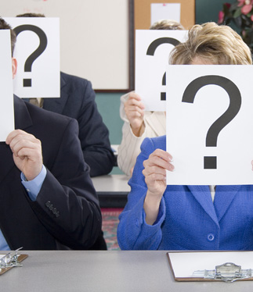
Is This Meeting Necessary?
  Is it worth the time and effort?
  Do you have a specific objective in mind?
  Is there a better way?
    E-mail
    Memo or report
    One-on-one conversations
    Conference call
    Request for written input
Notes:
Slide Show Notes
Of course, before you decide to call a meeting, it’s always a good idea to take a few minutes to answer the all-important question—Is this meeting really necessary?
Is it worth your time and the time of all the participants? Is it worth all the effort that you’ll have to put in to organize and run it effectively?
You should also consider if you have a specific objective in mind. Never hold a meeting just because it’s that time of day, week, or month—or because it’s been a long time since the last meeting. Make sure you’ve got a good reason for taking up everybody’s time.
You might also think about whether there’s a more efficient alternative to holding a meeting. For example, could you:
Provide information via e-mail?
Distribute a memo or written report?
Hold one-on-one conversations with participants?
Make a conference call?
Or make a request for written input from interested parties?

Slide 5

Select Participants
Does the participant have:
  Something to contribute?
  Something to learn?
  A stake in the outcome?
  Follow-up responsibilities?
  Decision-making responsibilities?
Notes:
Slide Show Notes
If you determine that a meeting is needed, the next step is to decide who should attend. Selecting participants is an important decision because it has a direct impact on the successful outcome of the meeting. You want to be sure those you invite have a good reason for being there. Does the participant have:
Something to contribute?
Something to learn?
A stake in the outcome of the meeting?
Follow-up responsibilities for matters that will be discussed at the meeting?
Decision-making responsibilities in regard to items on the meeting agenda?
Generally, the most effective meetings involve relatively small groups of participants. So you don’t want to pack the house with a lot of bodies that don’t need to be there.

Slide 6


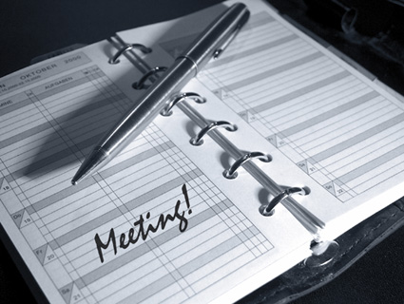
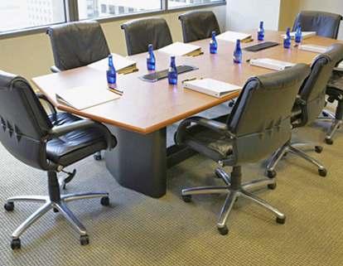
Plan the Details
  Date and time
  Place
  Materials
  Equipment
  Layout and Refreshments
Notes:
Slide Show Notes
The success of any meeting depends on some very important details.
First, you have to think about the date and time. What’s the best date for the meeting to ensure that all participants can attend? What’s the best time of day for the meeting? Morning meetings are often more productive. Be sure to avoid right after lunch and the end of the day, if possible.
Next, you have to decide where to hold the meeting. You need a place big enough to accommodate participants comfortably. You also want a quiet, private place, without a lot of distractions. And if you choose a conference room or some other venue that may be booked by others, be sure to reserve the place in plenty of time.
You also have to think about materials you need to prepare for
the meeting, such as handouts, reports, charts, PowerPoint presentations, and so on. Make sure to have enough copies of handouts prepared.
If you’ll need any equipment for the meeting, you have to plan for that, too. For example, will you need a laptop? Video or DVD equipment? Make a list of the equipment you need and make sure it’s on hand.
The layout of the meeting room is also important. Make sure you have enough chairs and that they’re arranged the way you want. And finally, if you’ll be serving coffee, juice, bottled water, or food, make sure you plan to have that delivered at the appropriate time.

Slide 7
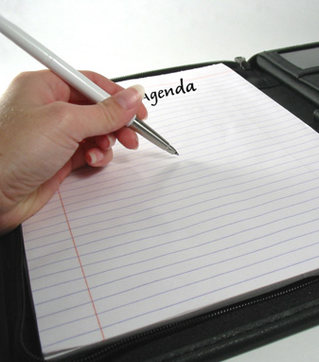
Prepare the Agenda
  State meeting objective
  Give time and location
  Provide the list of participants
  Itemize points to be covered
Notes:
Slide Show Notes
Every meeting needs a written agenda. The agenda gives structure and direction to the meeting and provides participants with vital information about the meeting.
A meeting agenda should always begin by clearly stating the objective of the meeting. Why is the meeting being held? Why is it important to attend?
The agenda should also give the time and location of the meeting, including the expected time the meeting will end.
It’s always a good idea to include a list of those who will attend the meeting so that participants know ahead of time who’ll be there.
Most important, of course, a meeting agenda must itemize the points to be covered. This is the heart of the agenda. Be sure to limit yourself to essential points only. Too many items on an agenda means a meeting that might run too long and try to accomplish too much—both of which could negatively affect the success of your meeting.

Slide 8
Prepare the Agenda (cont.)
  Arrange meeting points in a logical order
  State the purpose of each item
  Tell who is responsible for presenting
  each item
  Allocate time for each item
Notes:
Slide Show Notes
Be sure to arrange the points you’ll cover in a logical order. For example, sometimes you have to provide information before participants can discuss an issue. You might want to lead up to the most important issue by dealing with less important matters first. Or maybe you’ll decide to deal with old business before turning to new business.
In the agenda, briefly explain the purpose of each item on the agenda and tell who is responsible for presenting each item.
And don’t forget to allocate a specific time for each item right on the agenda. Whether it’s 2 minutes or 10 minutes, write it down so that everybody knows how much time is available for discussion of each point. Setting a strict timetable for the meeting in the agenda will later help you keep the meeting on track and end it on time. Be sure to allow at least a little time in the schedule for questions.
Do you always write an agenda for the meetings you conduct? Do your agendas contain all of this essential information?
Bring examples of meeting agendas to the session and distribute copies to trainees. Analyze them as a group for effectiveness and completeness.

Slide 9

Notify Participants
  Give participants advance notice
  Provide an agenda and background information
  Request input/information
  Make sure participants know what’s expected
Notes:
Slide Show Notes
Once the agenda is prepared, you’re ready for the next step in planning a meeting, and that is notifying participants. Always be sure to give participants as much advance notice of a meeting as possible—at least a few days. A week’s even better.
Send participants a copy of the agenda and any background information they need to read before the meeting.
If you expect participants to provide input or information before the meeting, make sure they understand exactly what you need from them. For example, you might ask participants to submit questions about items on the agenda so that you can prepare answers. Or you might ask them to submit specific information about issues on the agenda.
Also be sure to let participants know what will be expected of them at the meeting. Briefly explain what they should read, do, or think about in advance of the meeting. If they need to bring materials to the meeting, tell them exactly what they need to bring. If a participant is responsible for presenting an agenda item, make sure he or she knows what you want presented and how you want it presented.

Slide 10
Which of These Are Good Reasons for a Meeting?
☒
Long time since last meeting
Make decisions or solve problems
Exchange information
We always have a weekly/monthly meeting
Make plans
Distribute a written report
✓
✓
☒
✓
☒
Notes:
Slide Show Notes
Now, take a couple of minutes to think about the reasons for having a meeting that you see on the screen. Decide which of these is a good reason for having a meeting. Then we’ll review the correct choices.
[PAUSE] OK. Have you decided which of these are good reasons for having a meeting? Let’s see if you were right.
Long time since last meeting. Not a good reason for holding a meeting. Every meeting needs a real objective and purpose.
Make decisions and solve problems. Sure, these are great reasons for holding a meeting.
Exchange information. Keeping people up to date and providing vital information are very good reasons for a meeting.
We always have a weekly or monthly meeting. Not a good reason, unless you also have something essential to discuss with the group.
Make plans. Great reason for a meeting if you need to confer with others to develop strategies and anticipate challenges.
Distribute a written report. Bad reason. Just distribute the report and let people read it. Maybe you can have a meeting later to discuss the report.

Slide 11

Preparing for a Meeting
  Do you understand the information presented in the previous slides?
Notes:
Slide Show Notes
Now it’s time to ask yourself if you understand the information presented so far. Do you understand what we’ve discussed about planning and preparing for a meeting, preparing an agenda, and notifying participants?
The success of most meetings depends on careful planning and preparation.
Answer any questions trainees have about the information presented in the previous slides.
Conduct an exercise, if appropriate.
Now let’s continue to the next slide and talk about getting a meeting off to a good start.

Slide 12


Get the Meeting Off
To a Good Start
  Start on time
  Make a brief introduction
  Assign a person
  to take notes
  State when the meeting will end
  Distribute handouts
Notes:
Slide Show Notes
If you get your meetings off to a good start, you improve the chances that the outcome will be good, too.
Always start meetings on time. Don’t wait for latecomers.
Briefly introduce the purpose of the meeting. Also introduce guests—if any—and any participants who do not know one another.
Don’t forget to assign a person to take notes. You need an accurate record of the meeting so that you can prepare meeting minutes to distribute to participants. You can bring in an assistant to handle the note taking, or you can ask one of the meeting participants to do it. Some meeting leaders like to use a tape recorder, too.
State when the meeting will end. That way everybody knows there’s a limited amount of time to get the business of the meeting done. If it’s going to be a very long meeting and you’ve scheduled a break, tell participants approximately when the break will come.
And, distribute any handouts you have for participants. Everyone should already have the agenda, but be sure to have a few extra copies available for those who have forgotten theirs.
Think about how you start meetings. Do you include these points?
Ask trainees to describe how they usually start meetings.

Slide 13

Keep the Meeting Focused
  Stick to the agenda
  Explain how questions will be handled
  Control the discussion
  Prevent multiple or side conversations
  Note important unanticipated topics
  for later discussion/
  follow-up
Notes:
Slide Show Notes
To keep your meetings focused, stick to the agenda. Only modify your agenda if a critical issue arises that absolutely must be discussed right away.
Make it clear how questions will be handled. You might want participants to ask questions as you go along or hold questions until a topic has been discussed.
As meeting leader, it’s your job to control the discussion and keep the meeting moving forward. You have to be prepared to jump in and cut off discussion of unrelated topics. You must sense when all the important points have been made and it’s time to move on. Try to rule with a firm but light hand. Facilitate rather than dictate. A little humor at the right time can also help reduce tension and keep things moving.
One thing you want to be strict about, however, is multiple or side conversations. These are distracting and counterproductive. Don’t allow them. You want everyone to focus on and participate in the same discussion.
If important topics not on the agenda arise from discussion and you don’t have time to deal with them, note them for later discussion or follow-up. Perhaps such issues might become agenda items for future meetings.

Slide 14

Encourage Participation
  Establish open communication
  Ask for ideas, comments, and questions
  Involve all participants
  Encourage building
  on ideas
  Manage disagreements and conflicts
Notes:
Slide Show Notes
As meeting leader, it’s also your job to encourage participation and involve all participants as fully as possible in the meeting. To encourage full and useful participation establish an atmosphere that promotes open communication. Set a good example, by presenting your ideas in a positive, straightforward manner. Listen attentively to what others have to say. Criticize constructively when necessary. And require courtesy and respect from all and for all participants.
Ask for ideas, comments, and questions whenever appropriate, to stimulate discussion of the issues.
Try to involve all participants. If some participants fail to contribute to the discussion, ask them their opinions to draw them out.
Also, encourage participants to build on one another’s ideas. This is a good way to get people involved in a discussion and often produces some useful results.
Finally, manage disagreements and conflicts effectively. Arguments can waste a lot of time and accomplish nothing. Firmly end arguments that are off topic. Let useful disagreements continue until you reach the point where nothing new is being said, and them bring them to an end.
Think about the methods you use to encourage participation in meetings. Which ones work best?
Ask trainees to describe how they encourage participation in meetings.

Slide 15

End the Meeting
On Time and on Target
  Begin to wind up
  5 minutes early
  Summarize
  Seek agreement/approval
  Confirm accuracy of
  meeting notes
Notes:
Slide Show Notes
Ending meetings well is as important as beginning them well. You want to end on time and on target.
Begin to wind up at least 5 minutes before the scheduled conclusion of the meeting.
Summarize what has been covered and accomplished in terms of your original objectives as stated in the agenda.
Seek agreement on or approval of what was discussed and decided during the meeting. Ask for consensus. Take a vote, if appropriate.
Also take a moment before the end of the meeting to make sure your note taker has recorded all the key information, including decisions, solutions, idea, promises, recommendations for action, and so on.

Slide 16

End the Meeting on Time
And on Target (cont.)
  Review follow-up assignments
  Establish deadlines
  Set future meeting dates
  Thank participants
Notes:
Slide Show Notes
Review follow-up assignments and make sure everyone who has an assignment knows what to do.
Establish deadlines for follow-up action as well.
Set a date to meet again if another meeting is required to cover additional issues or review follow-up findings. If this is a routine meeting, such as a monthly staff meeting, set a date for the next one.
And finally, don’t forget to thank participants for their time and contributions.
Think about the way you normally end meetings. Do you have an organized plan for concluding meetings successfully?
Ask trainees to describe how they end meetings. Do they take all of the steps listed in this and the previous slide? What else do they do?

Slide 17
Conduct a
Post-Meeting Analysis
  Did the meeting follow the agenda?
  Were you able to keep to your timetable?
  Was the meeting focused?
  Was there enough participation?
  Do you need another meeting?
Notes:
Slide Show Notes
In football and other sports, coaches conduct a post-game analysis to see where the team excelled and where it went wrong. You can briefly do the same with your meetings—especially big, important meetings.
Answering questions such as these can help you analyze meetings and improve future meetings:
Did the meeting follow the agenda? Were all items adequately covered? If not, why not?
Were you able to keep to your timetable for each item on the agenda and for the meeting itself?
Was the meeting well focused, or did it drift and ramble?
Was there enough participation, or did some people dominate the discussion?
Do you need another meeting, either to complete the agenda or deal with new issues that arose during the meeting?

Slide 18
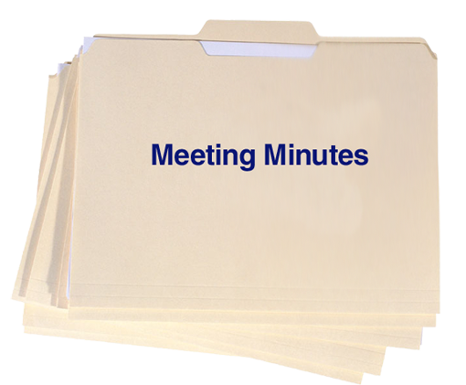
Prepare and Distribute
The Meeting Minutes
  Date, time, participants
  Summary of issues
  discussed
  Decisions made/
  problems solved
  Follow-up assignments
  and deadlines
  Copies for each participant and other interested parties
Notes:
Slide Show Notes
One of your most important follow-up responsibilities as meeting leader is to prepare and distribute the meeting minutes. Minutes provide a brief outline of the meeting and highlight important information. Minutes should always include:
The date and time of the meeting as well as a list of participants;
A summary of issues discussed;
Decisions made and/or problems solved; and
A brief review of follow-up assignments and a deadline for action.
Make sure that each participant receives a copy of the minutes as soon after the meeting as possible. Other copies may be distributed to people who missed the meeting and to other interested parties, such as other supervisors, people in upper management, your boss, and so on.
Do you always prepare and distribute meeting minutes? You should. They document the meeting and provide an important reminder of what was covered and what still remains to be done.
Bring examples of well-written meeting minutes to the session and distribute them to trainees. Discuss what makes those minutes good.

Slide 19

Why Meetings Fail
  Lack of purpose and/ or focus
  Inadequate preparation
  Too many people or not the right people
  Poor leadership
  No follow-up
Notes:
Slide Show Notes
Now let’s just take a minute to look at five key reasons why meetings sometimes fail to achieve their objectives.
Lack of purpose and/or focus. If you don’t have a specific reason for having a meeting, don’t have it. Communicate in some other, more effective way.
Inadequate preparation. Without adequate planning, the right agenda, and the necessary information and materials, you’re likely to waste everybody’s time and achieve few positive results.
Too many people or not the right people. For example, if the meeting is supposed to make decisions but the decision makers aren’t present, nothing useful is going to happen.
Poor leadership. Lack of control can result in a meeting that drifts off topic, gets caught up in useless arguments, and fails to achieve objectives.
No follow-up. If people don’t go out and take the actions they’re supposed to take after a meeting, then the meeting itself was a waste of time.

Slide 20


Conducting Effective Meetings: True or False?
Wait for latecomers before starting a meeting.
The agenda is only a guide; you don’t have to stick to it.
Try to get all participants to voice
their views.
Let a meeting run as long as it needs to.
Notes:
Slide Show Notes
Now let’s test your knowledge about conducting effective meetings with a little true/false test.
You should always wait for latecomers before starting a meeting. True or false? [PAUSE] The correct answer is false. Always start meetings on time. Don’t wait for latecomers.
The meeting agenda is only a guide; you don’t have to stick to it. True or false? [PAUSE] The correct answer is false. Always stick to the agenda. It provides structure and direction for the meeting.
Try to get all participants to voice their views. True or false. [PAUSE] The correct answer is true. Try to draw out people who haven’t contributed by asking their opinions.
Let a meeting run as long as it needs to. True or false? [PAUSE] The correct answer if false. End meetings on time, just as you begin them on time.
How did you do? Did you get all the answers right?

Slide 21

Conducting
Effective Meetings
  Do you understand the information presented in the previous slides?
Notes:
Slide Show Notes
Do you understand all the information we’ve discussed in the previous slides about conducting effective meetings? Remember, we’ve talked about starting and ending the meeting well, keeping the meeting focused, and encouraging participation. We’ve also suggested reasons why meetings fail.
It’s important to understand this information if you want to conduct efficient meetings that achieve positive results.
Answer any questions trainees have about the information presented in the previous slides.
Conduct an exercise, if appropriate.
Now let’s go on to the next slide and discuss participating effectively in other people’s meetings.

Slide 22
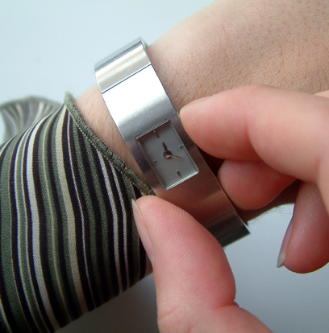
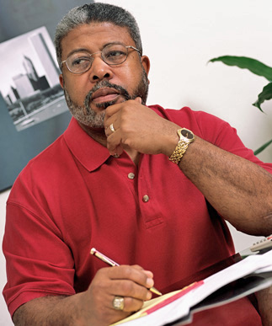

How to Participate More Effectively in Meetings
  Be on time
  Come prepared
  Listen
  Take notes
Notes:
Slide Show Notes
When you’re not leading your own meetings, you’re probably being asked to participate in other people’s meetings. The key to participating effectively in a meeting is to take your share of responsibility for the success of the meeting. How can you do that?
Be on time. Coming late is disruptive and disrespectful to other participants and the meeting leader. It may also cause you to miss something important.
Come prepared. Think about the agenda. Read any background information that’s been provided, or do a little research on your own. Also prepare any presentations you’ve been asked to make and bring any information you’ve been asked to bring.
Listen courteously and attentively to others. Don’t interrupt people. Wait your turn to speak. And really listen to what others have to say.
Take notes. Even though minutes will be distributed later, it’s a good idea to note your own impressions of what is being said.

Slide 23
How to Participate More Effectively in Meetings (cont.)
  Speak briefly and to the point
  Keep to the agenda
  Offer constructive feedback
  Perform follow-up responsibilities on time
Notes:
Slide Show Notes
When you have something to say, speak briefly and to the point. Remember that time is limited and other people have contributions to make as well.
Keep to the agenda. Don’t bring up unrelated topics or issues.
Offer constructive feedback. Remember the golden rule of feedback—criticize actions and ideas, not people.
Perform follow-up responsibilities on time. Make sure you take whatever action is necessary and report as requested to the meeting leader and/or other participants in a timely manner.
Think about the steps you take to participate effectively in meetings. Do you take all these steps? What else do you do?
Ask trainees to describe the steps they take to participate effectively in meetings.

Slide 24

  Hold meetings only when necessary
  Invite the right participants and follow an agenda
  Make sure all preparations are made
  Start and finish on time
  Keep the meeting focused and encourage participation
  Summarize and review follow-up assignments
Notes:
Slide Show Notes
Here are the main points to remember from this session on effective meetings:
Hold meetings only when necessary;
Invite the right participants and follow an agenda;
Make sure all necessary preparations for the meeting have been made;
Start and finish on time;
Keep the meeting focused and encourage participation; and
Summarize accomplishments and review follow-up assignments.
This concludes the effective meetings training session.
Give trainees the quiz, if appropriate.

